Slide 1

Azure Purview #1
Unified data governance to maximize the business value of data
Michał Gołojuch, FastTrack Engineer
Situmalli Chandra Mohan, Senior FastTrack Engineer

Slide 2
- Introduction to Azure Purview - Deployment options - Pricing - Scanning Assets - Default and custom classifications - Security (roles) - QA
Agenda:

Slide 3


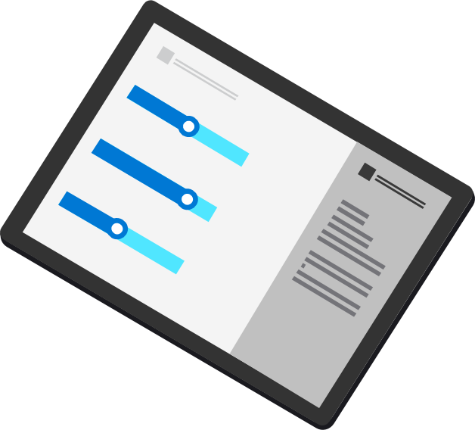
Azure Purview
Azure Purview
UNIFIED DATA GOVERNANCE
Data Insights
Data Map
Automate and manage metadata at scale
Data Catalog
Data Catalog
Enable effortless discovery for data consumers
On-prem
Multicloud
Data Map
Data Insights
Assess data usage across your organization
SaaS

Slide 4
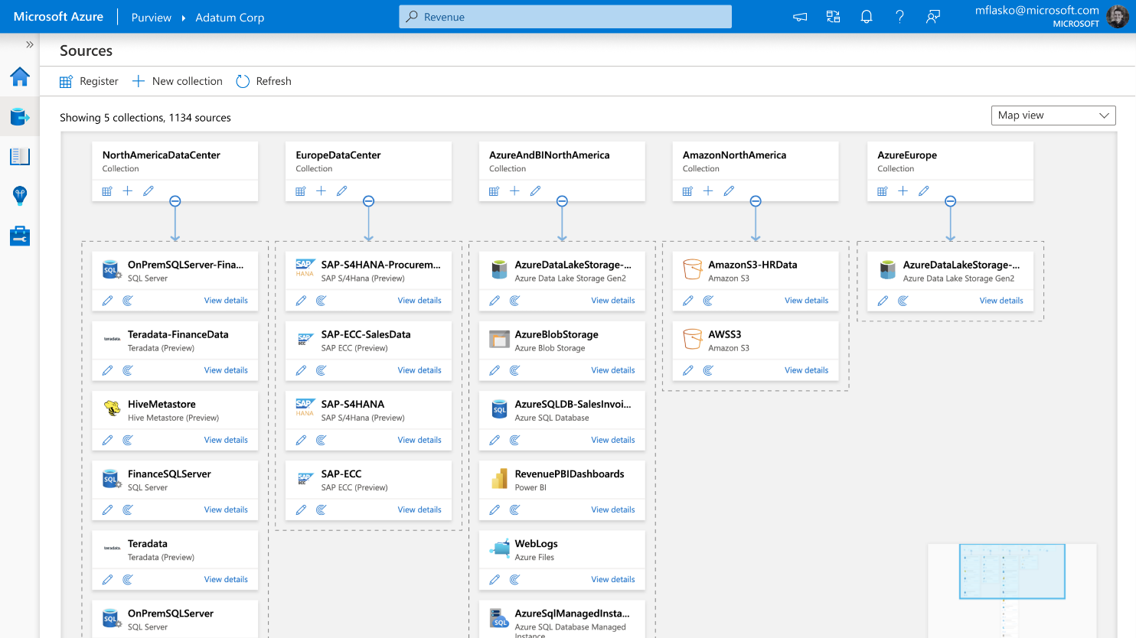
Unify and make data meaningful using Purview Data Map
Automated metadata scanning and lineage identification of hybrid data stores
100+ built-in and custom classifiers
Microsoft Information Protection sensitivity labels

Slide 5

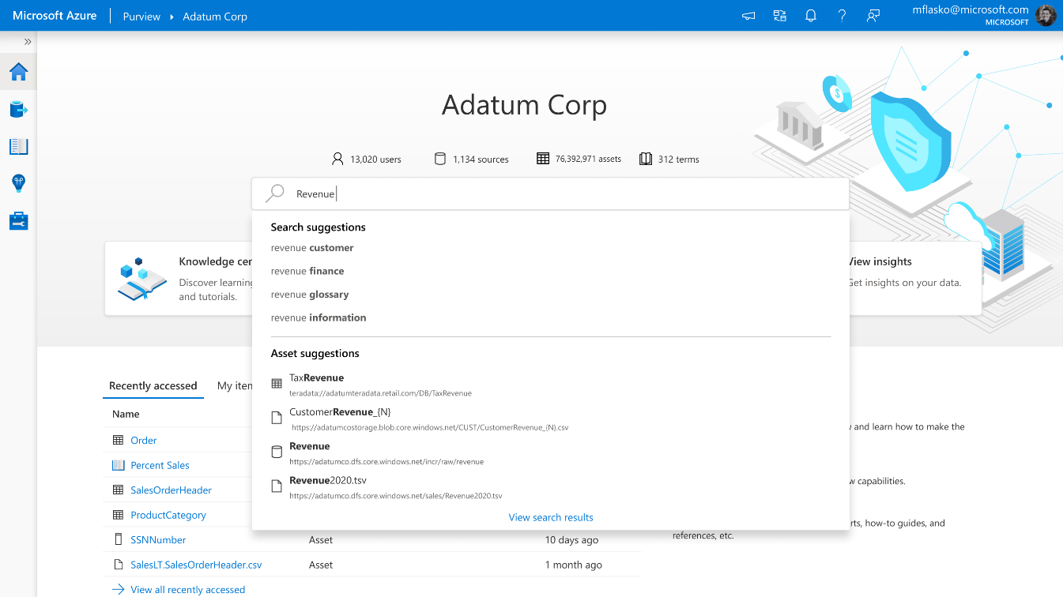

Enable effortless discovery with Purview Data Catalog
Semantic search and browse
Business glossary and workflows
Data lineage with sources, owners, transformations, and lifecycle

Slide 6
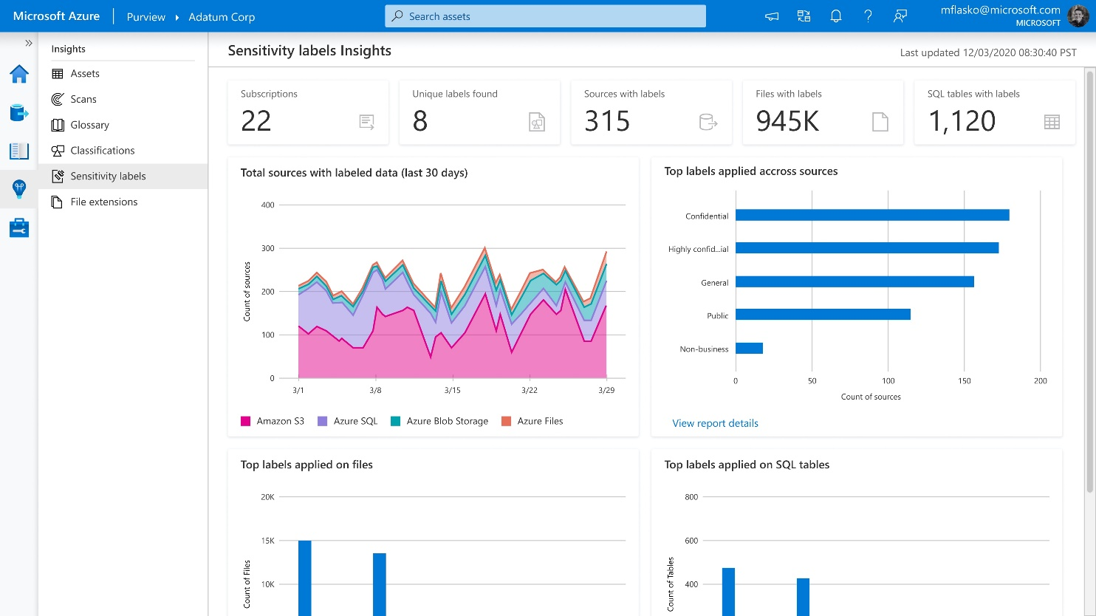


Get a bird’s-eye view of sensitive data with Data Insights
Reports on Assets, Scans, Glossary, Classification, and Labeling

Slide 7
Azure Purview: Unified Data Governance
Azure Purview
Power BI
SQL Server on-prem
Azure Synapse
Azure Data Services
M365 Compliance Center
Unified Experience
Data Catalog
Data Insights
Search
Business Glossary
Lineage
Data use reports
Publish, Discover & Curate Data
Unified Platform
“Data Map” = Data Assets | Lineage | Classifications
Open APIs
Automated Scanning & Classification
(Apache Atlas 2.0)
On-prem & Multicloud Operational, Analytical, SaaS
Notes:
Maximize business value of data with Azure Purview, a unified data governance solution, across operational and transactional data. Enable business and technical analysts to find, interpret and trust data with an intuitive catalog. Get insights and ensure data usage is governed within compliance guardrails.
Azure Purview is a unified data governance service. It organizes vast metadata that enables organizations to break down silos and derive meaning from data. Once data can be understood and annotated, it then lends itself to several applications – the first of which, we announced at public preview, being data catalog and data insights. In the future, privacy, quality and master data management value will follow.

Slide 8

Azure Purview - Demo

Slide 9
Azure Purview Features
Azure Purview
Azure Purview Studio
Data Producers &
Consumers
Data Officers & Security Officers
Power BI
SQL Server on-prem
Azure Synapse
Azure Data Services
M365 Compliance Center
Azure Purview Catalog (C1)
Azure Purview Data Insights (D1)
Business Glossary templates
Lineage visualization & workflows
Catalog Insights (Asset, Scan, Glossary)
Sensitive Information Types & Labeling insights
Azure Purview Catalog included with Platform (C0)
Search, browse, asset details
Automated meta-data and lineage extraction
Automated classification based on content inspection
Private Endpoint
Management center
Azure Purview Platform
Data Map
Dedicated per customer on shared infra
Provisioned default capacity with option to add-on capacity
Automated Scanning & Classification
Open APIs
Serverless, pay per use
Includes connectors, scanning of sources, processing into data assets, lineage capture, classification
(Apache Atlas 2.0)
On-prem & Multi-cloud*
Operational, Analytical, SaaS*
* Power BI, SQL Sever on-prem, Azure Data Services including Synapse, Cosmos DB & Storage, Non-Microsoft systems including SAP ECC, SAP S4 HANA & Teradata, Multi-cloud systems including AWS S3
Notes:
With Purview Platform:
Automate scanning and classification of multicloud, SaaS, on-prem data. 25 plus out of box connectors and file formats supported
Modernize homegrown catalogs built on opensource technology with Babylon using Apache Atlas APIs supported out-of-the-box
Get catalog features (C0 Tier) for FREE included with Purview platform:
Search and browse
Empower business and technical data analysts via a catalog to find and interpret data.
Power data scientists and engineers with business context to drive BI, Analytics, AI and ML initiatives
Automated metadata and lineage extraction
Enrich the business value of data with technical, business and semantic metadata
Scale understanding of data with automated, fully managed, serverless metadata management capability
Leverage support of Apache Atlas’s open-source Lineage APIs to push lineage information into the Purview Data Map.
Analyze impact of changes to data and understand dependencies visually.
Azure Purview Catalog (C1 Tier) includes the following in addition to the free features included with the platform:
Business Glossary
Deliver a curated and consistent understanding of business terms and definitions.
Import existing glossary terms from existing data dictionaries easily.
Also add ability to define custom attributes for the glossary terms and create templates for different domains like ‘Finance’, ‘Sales’ etc.
Lineage views
Ensure data provenance with a visual representation of owners, sources, transformation, and lifecycle
Built-in integrations with solutions to automatically extract lineage such as Synapse Analytics, Azure Data Factory, Azure Data Share etc.
Data Insights (D1 Tier) provides a bird’s eye view of your data landscape intended to help users such as Chief Data Officers quickly understand their data estate at large and gain key insights such as where sensitive data resides. It includes:
Catalog insights:
Asset Insights: Quickly see where all your data resides across a range of data sources
Scan Insights: Success/failures/cancellations over a period
Glossary Insights: Quickly understand changes made to the glossary over time and assess how much coverage glossary has over your data map.
Sensitive data insights
Simplify compliance risk assessment across all your operational and transactional data sources.
Assess risk and derive audit trails of data qualified by sensitivity and business relevance.

Slide 10
Azure Purview Features
Topics for session #2:
Azure Purview
Azure Purview Studio
Data Producers &
Consumers
Data Officers & Security Officers
Power BI
SQL Server on-prem
Azure Synapse
Azure Data Services
M365 Compliance Center
Azure Purview Catalog (C1)
Azure Purview Data Insights (D1)
Business Glossary templates
Lineage visualization & workflows
Catalog Insights (Asset, Scan, Glossary)
Sensitive Information Types & Labeling insights
Azure Purview Catalog included with Platform (C0)
Search, browse, asset details
Automated meta-data and lineage extraction
Automated classification based on content inspection
Private Endpoint
Management center
Azure Purview Platform
Data Map
Dedicated per customer on shared infra
Provisioned default capacity with option to add-on capacity
Automated Scanning & Classification
Open APIs
Serverless, pay per use
Includes connectors, scanning of sources, processing into data assets, lineage capture, classification
(Apache Atlas 2.0)
On-prem & Multi-cloud*
Operational, Analytical, SaaS*
* Power BI, SQL Sever on-prem, Azure Data Services including Synapse, Cosmos DB & Storage, Non-Microsoft systems including SAP ECC, SAP S4 HANA & Teradata, Multi-cloud systems including AWS S3
Notes:
With Purview Platform:
Automate scanning and classification of multicloud, SaaS, on-prem data. 25 plus out of box connectors and file formats supported
Modernize homegrown catalogs built on opensource technology with Babylon using Apache Atlas APIs supported out-of-the-box
Get catalog features (C0 Tier) for FREE included with Purview platform:
Search and browse
Empower business and technical data analysts via a catalog to find and interpret data.
Power data scientists and engineers with business context to drive BI, Analytics, AI and ML initiatives
Automated metadata and lineage extraction
Enrich the business value of data with technical, business and semantic metadata
Scale understanding of data with automated, fully managed, serverless metadata management capability
Leverage support of Apache Atlas’s open-source Lineage APIs to push lineage information into the Purview Data Map.
Analyze impact of changes to data and understand dependencies visually.
Azure Purview Catalog (C1 Tier) includes the following in addition to the free features included with the platform:
Business Glossary
Deliver a curated and consistent understanding of business terms and definitions.
Import existing glossary terms from existing data dictionaries easily.
Also add ability to define custom attributes for the glossary terms and create templates for different domains like ‘Finance’, ‘Sales’ etc.
Lineage views
Ensure data provenance with a visual representation of owners, sources, transformation, and lifecycle
Built-in integrations with solutions to automatically extract lineage such as Synapse Analytics, Azure Data Factory, Azure Data Share etc.
Data Insights (D1 Tier) provides a bird’s eye view of your data landscape intended to help users such as Chief Data Officers quickly understand their data estate at large and gain key insights such as where sensitive data resides. It includes:
Catalog insights:
Asset Insights: Quickly see where all your data resides across a range of data sources
Scan Insights: Success/failures/cancellations over a period
Glossary Insights: Quickly understand changes made to the glossary over time and assess how much coverage glossary has over your data map.
Sensitive data insights
Simplify compliance risk assessment across all your operational and transactional data sources.
Assess risk and derive audit trails of data qualified by sensitivity and business relevance.

Slide 11
Q / A

